Slide 1
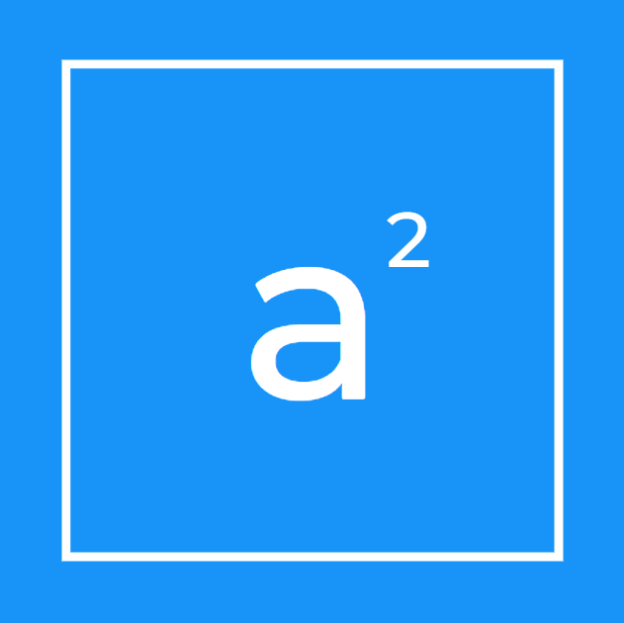
Accelerating
Accessibility

Slide 2


A day in the life of a high school student

Slide 3

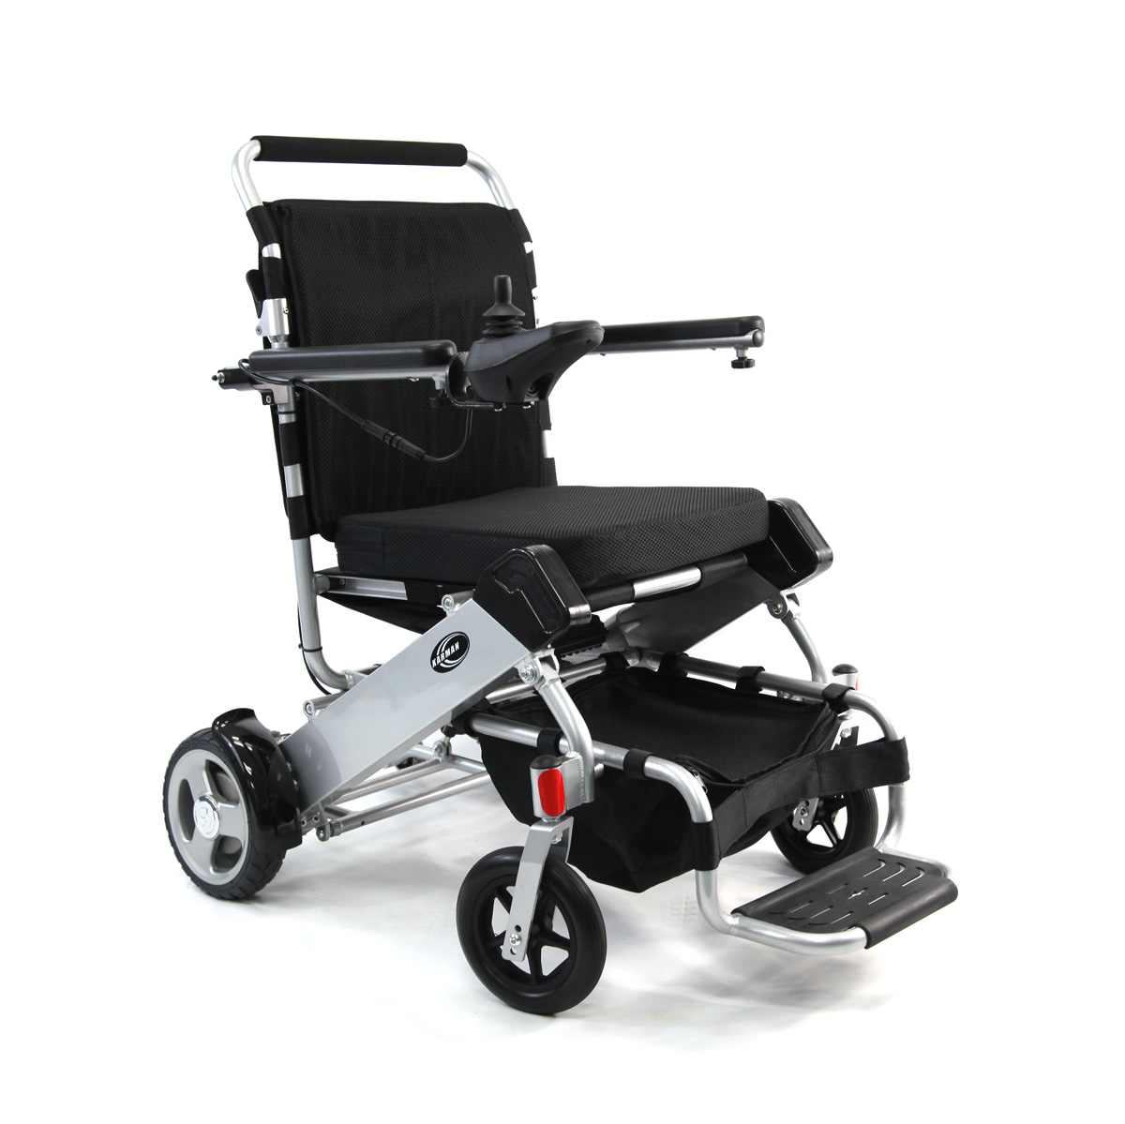
But Imagine….

Slide 4

Our Mission
We strive to make human interaction with technology intuitive and truly accessible for all people.

Slide 5
The First Step
Our first step in this market is to connect teens affected by cerebral palsy to smartphones. We will focus only on this during our first year.

Slide 6

Problem Statement
As of 2019, 133,000+ children between the ages of 12-18 live with a form of severe CP , which drastically reduces motor control and results in feelings of isolation, dependence, and a lack of self worth.

Slide 7


Existing Solutions
Only Web-browsing
Low user-rating and retention rate

Slide 8

Our Solution

Slide 9
State Machine

Slide 10
Music Player and Testing

Slide 11
Google Assistant Integration for Access to all apps

Slide 12
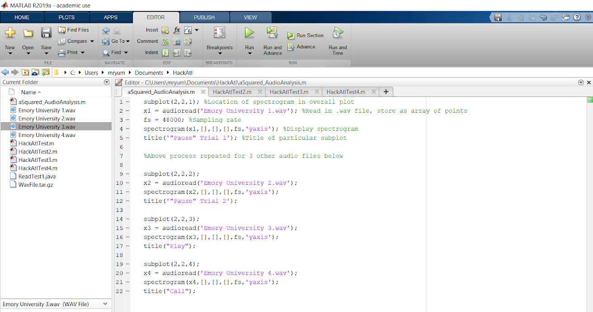

Slide 13
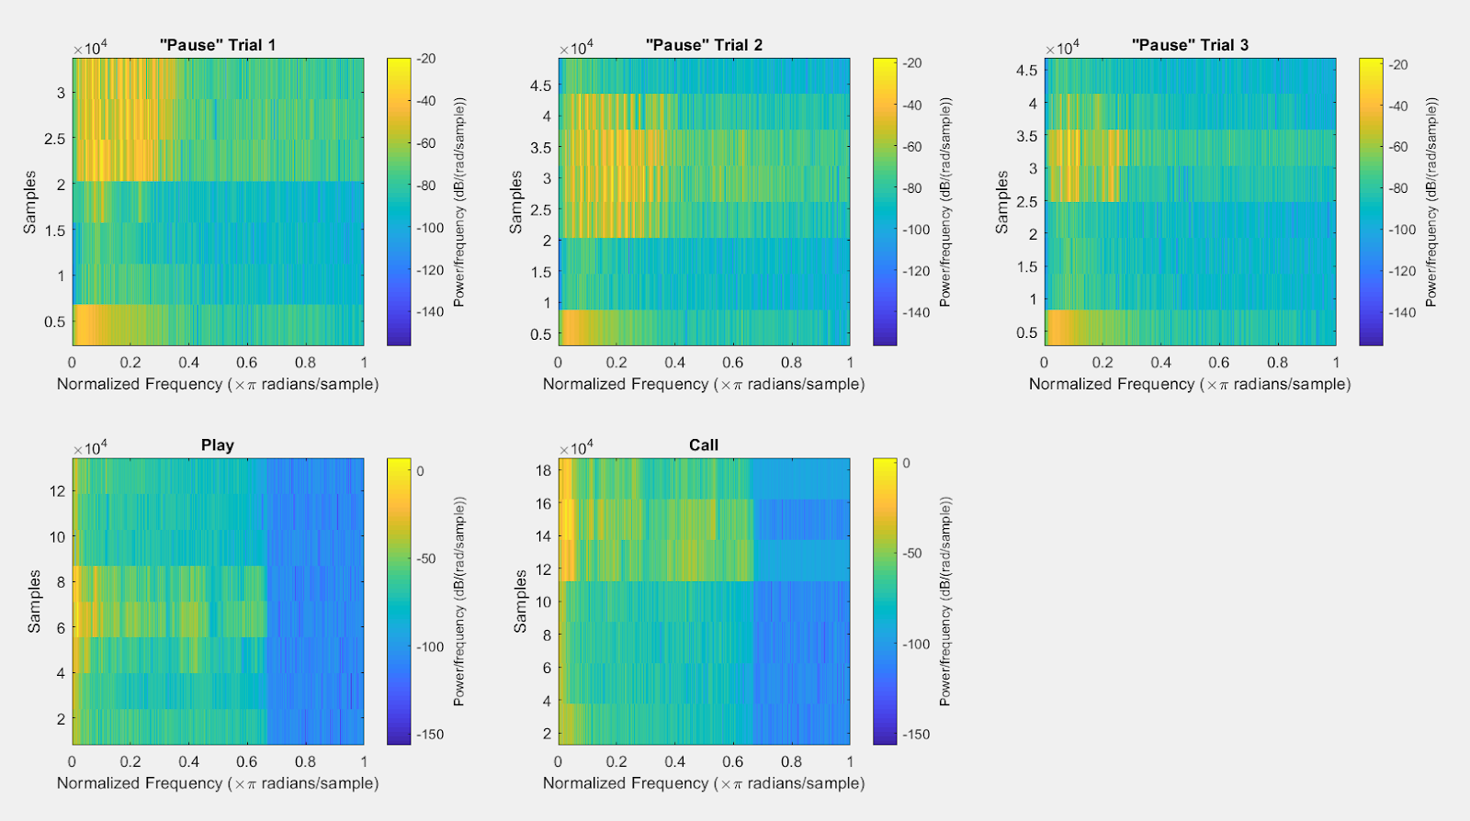
Audio Comparison Algorithm – Raw Data

Slide 14
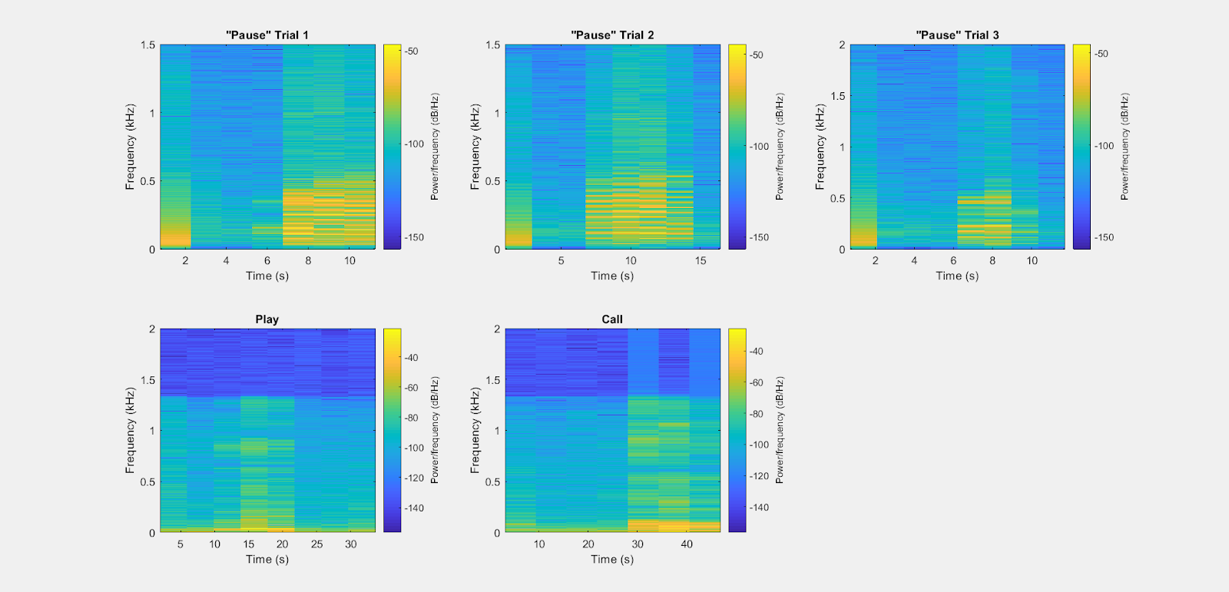
Comparison Algorithm Analysis

Slide 15
Finances
Revenue
$4.80 Million
Costs
$42,260
First Year Projections
Notes:
With successful marketing, this market is very profitable

Slide 16

Marketing
In order to earn $4.80 million we have to market excessively before our release
To popularize our product, we have three approaches that we will take
Support Groups
Special Need Programs in Schools
Social Media Presence

Slide 17
Target Market Share
After marketing, we plan to acquire a 30% market share of the total 133,000 teens affected by severe Cerebral Palsy
Ideal Market (Total Targeted Population) = 133,000
Realistic Market Share: 30% of 133,000 ~ 40,000

Slide 18
Revenue
Price of our app: $10 per month subscription fee
Market Share * Price = Revenue
40,000 * $10 = $400,000 Per Month
$4.80 Million in our first year

Slide 19
Estimated Costs
Mobile App Costs
IOS & Android Platform | $5,000
Custom Branded UI | $2,500
Account Login | $700
Basic Security Measure | $850
Payment Feature | $3,000
Database | $2,000
Extra App Features | $4,500
App Management | $3,710
Total | $22,260
Startup Costs
Marketing | $6,000
Consultation Fees | $2,500
Taxes | $6,500
Legal Costs | $5,000
Total | $20,000
First Year Total Cost - $42,260

Slide 20
The Team
Harish
Hustler
Lokranjan Hustler
Danielle
Hacker
Arundhati
Hacker
Yuma
Hipster

Slide 21
Business Plan – The Next Steps
Essentials app for students
OS Skin for antonymous smartphone use
Improve interface for other electronic devices
First Year
Third Year
Sixth Year

Slide 22
Expanding Our Market Over The Years
$500 Million + Potential
133,000 People
5.4 Million People
Profits earned over the initial years will be reinvested to expand our market and make technology fully accessible for people with physical disabilities

Slide 23
Sources
https://www.disabled-world.com/medical/rehabilitation/therapy/music.php
http://greateratlantaspeech.com/physical-therapy/
https://childdevelopment.com.au/areas-of-concern/fine-motor-skills/fine-motor-skills/
https://research.cerebralpalsy.org.au/what-is-cerebral-palsy/how-cerebral-palsy-affects-people/
https://www.christopherreeve.org/living-with-paralysis/stats-about-paralysis
https://www.sharecare.com/group/riverside-center-for-neurosciences
https://www.disability-benefits-help.org/how-disabling-is-my-condition/quadriplegia

